Slide 1
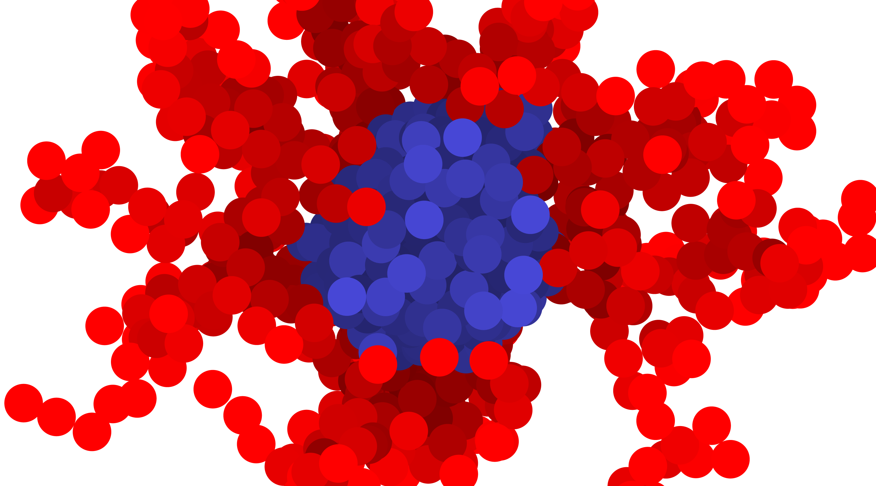
Polymer Conformation
Samuel Varner
November 22, 2024
Notes:
Hello all and thank you for attending my talk! I am a student in Zhen-Gang Wang’s group at Caltech, and today I have the privilege of presenting some of my work into the exchange mechanism for diblock copolymer micelles. This work was done in collaboration with professors Marcus Muller, Alejandro Gallegos, Timothy Lodge, and Kevin Dorfman.

Slide 2

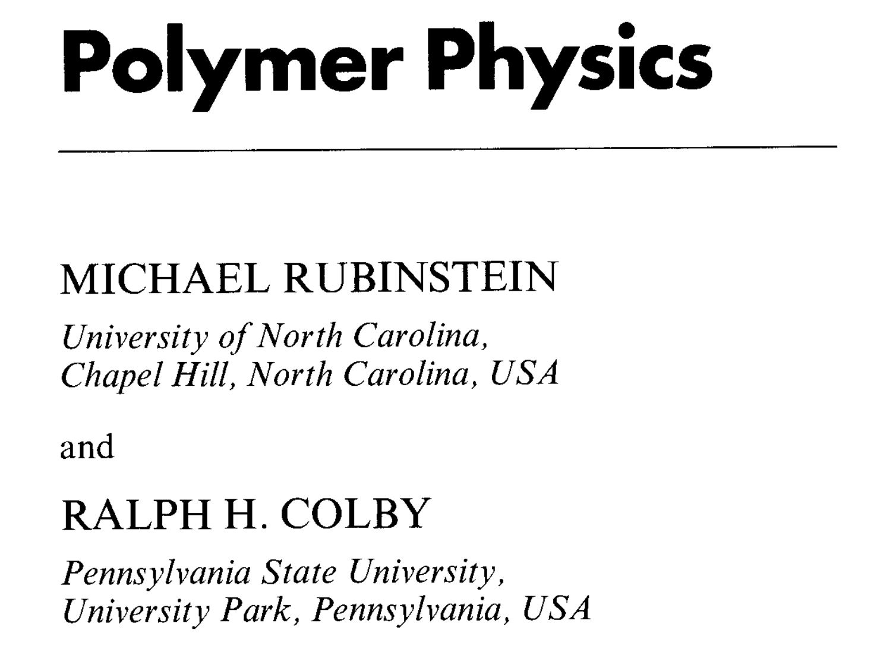
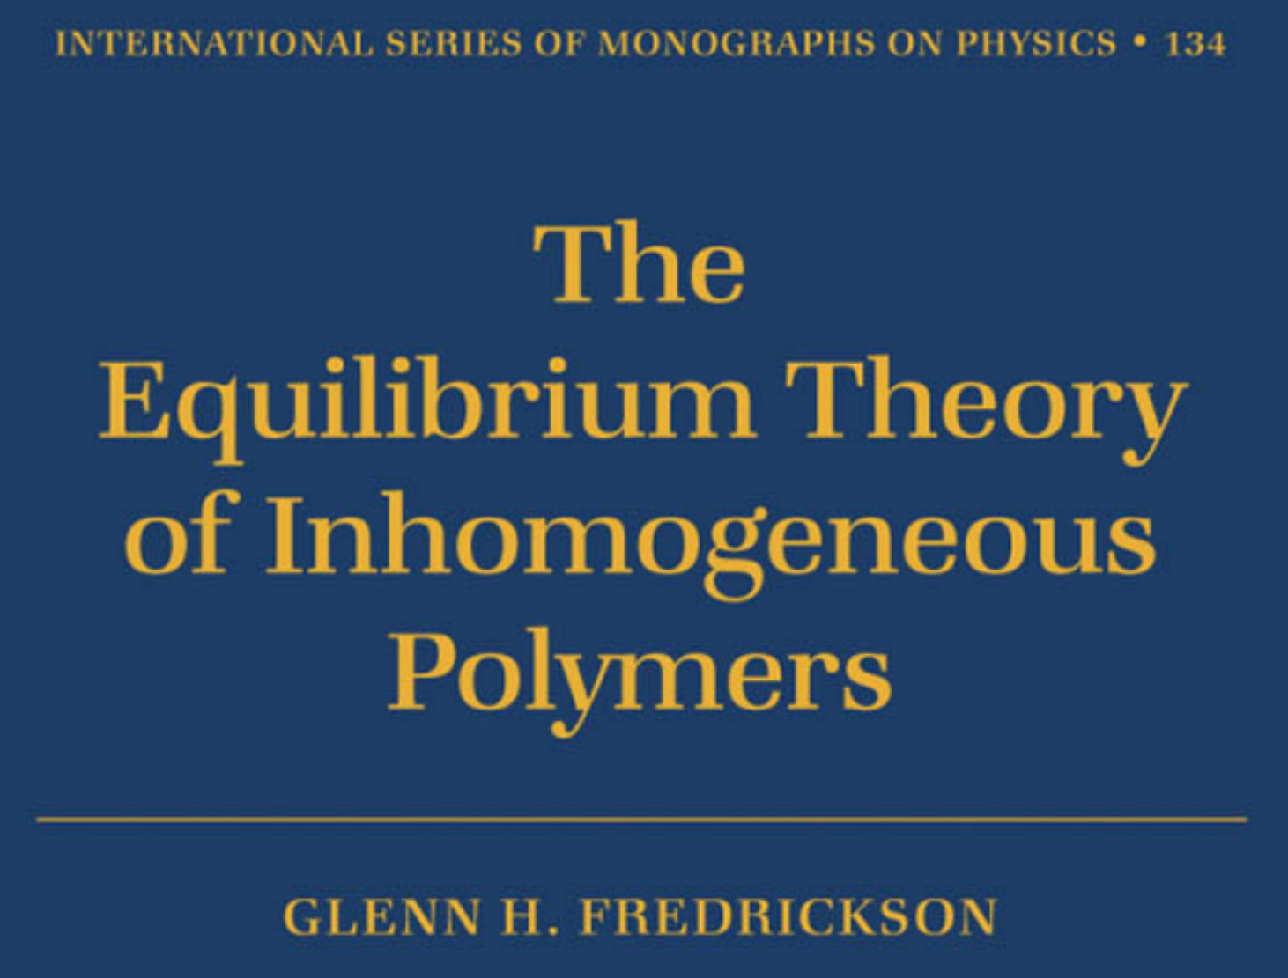
Cannot cover everything today!

Slide 3
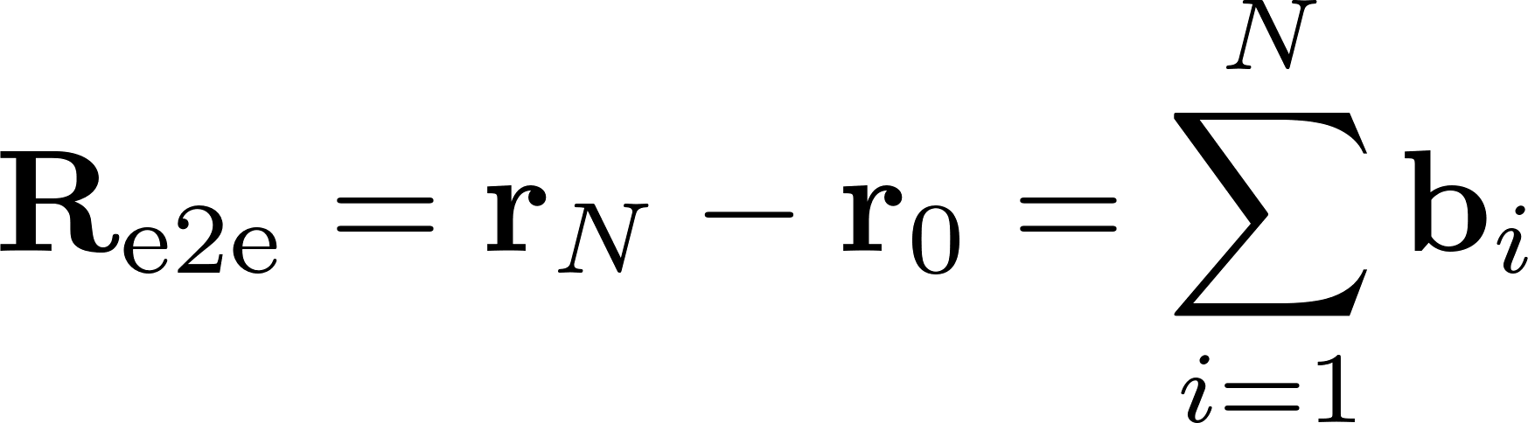
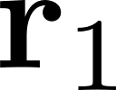
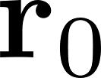
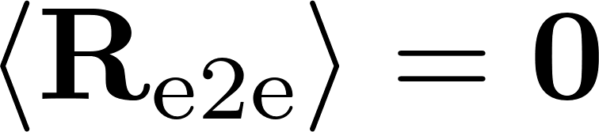
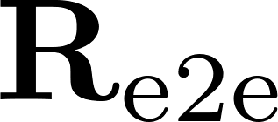

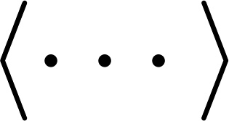
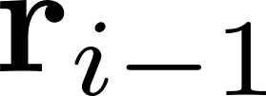
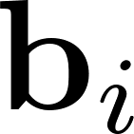
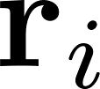
Ideal Chain – Basics
Monomers separated by enough bonds do not interact
Random walk where bonds are steps
Bonds have no preferred direction!
Indicates ensemble average (over many chains or over many conformations)

Slide 4
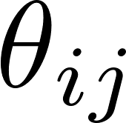
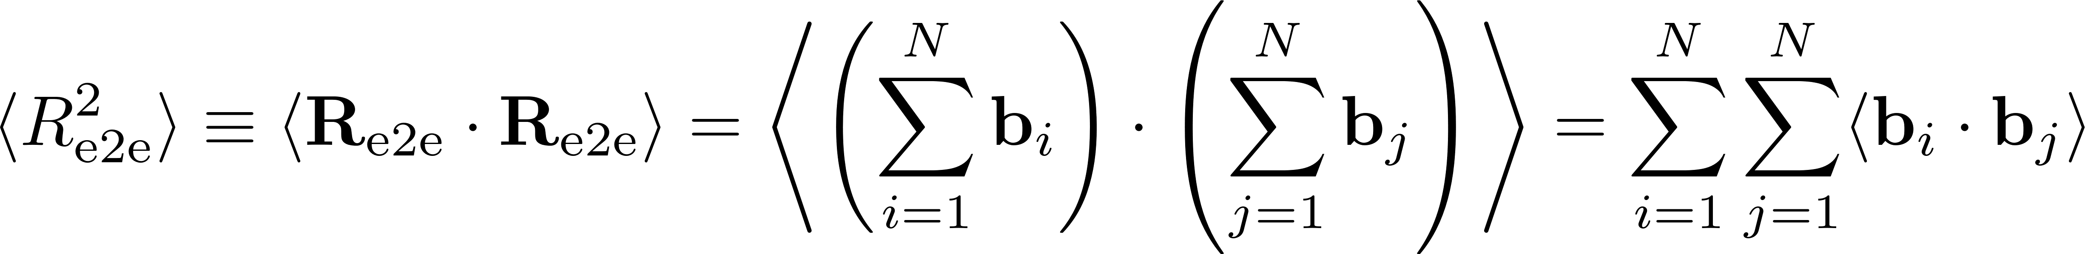
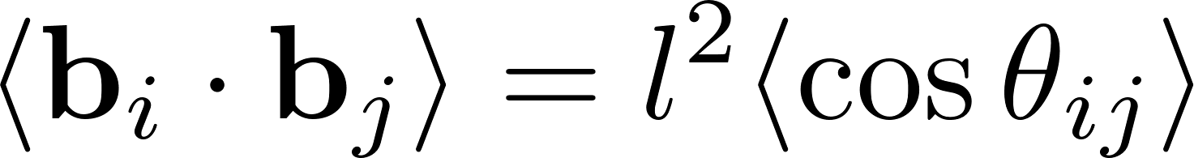
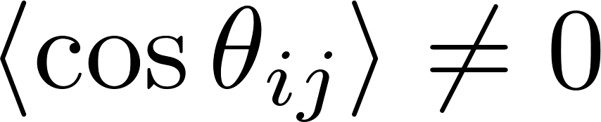
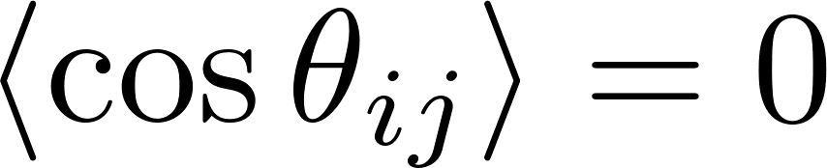
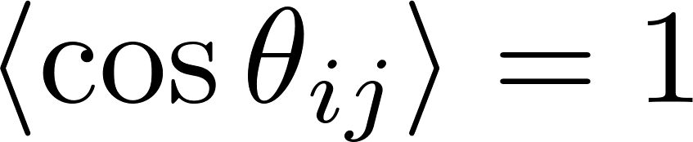
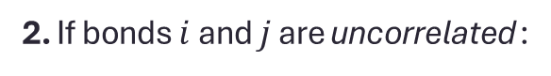
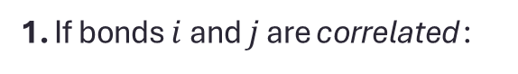
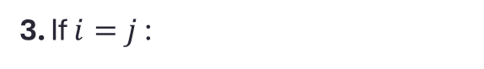
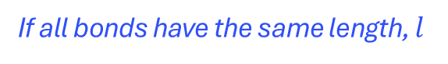
Ideal Chain – Characteristic Size
Mean-Square End-to-End Distance
If all bonds have the same length, $l$
1. If bonds $i$ and $j$ are correlated :
2. If bonds $i$ and $j$ are uncorrelated :
3. If $i=j$ :

Slide 5
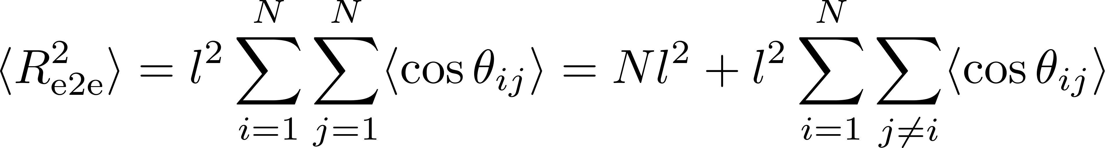
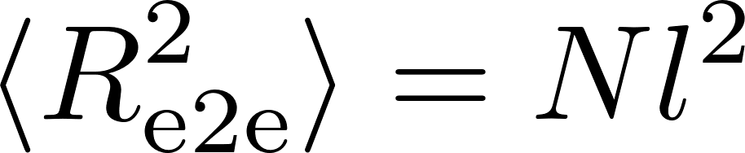
Ideal Chain – No Correlations
Mean-Square End-to-End Distance
In the absence of bond-bond correlations

Slide 6
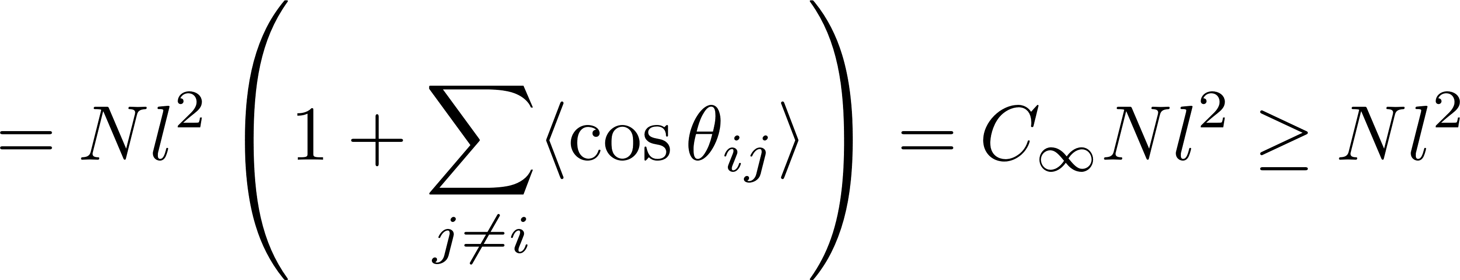
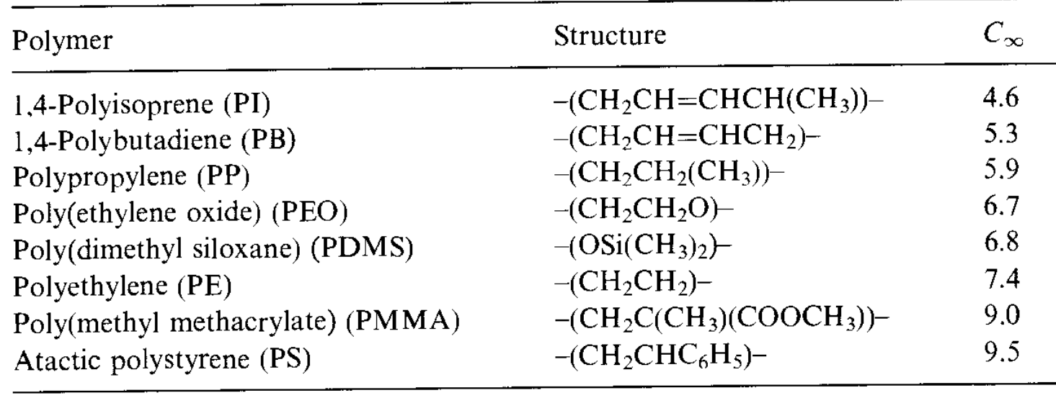
Ideal Chain – Correlations
Mean-Square End-to-End Distance
Accounts for correlations due to steric hinderance across chain and augments ideal behavior

Slide 7
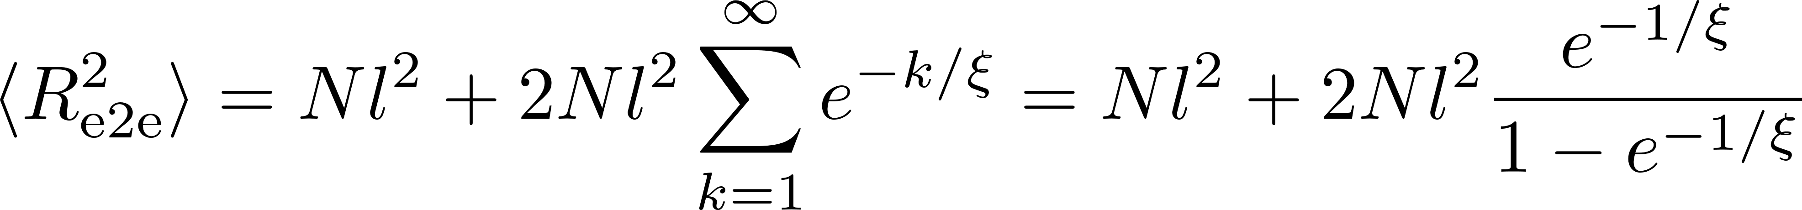
Ideal Chain – Correlations Example
(Example) Correlations that decay exponentially
Correlation length
Correlations decay rapidly (small $ξ$)… extend sums to $∞$

Slide 8
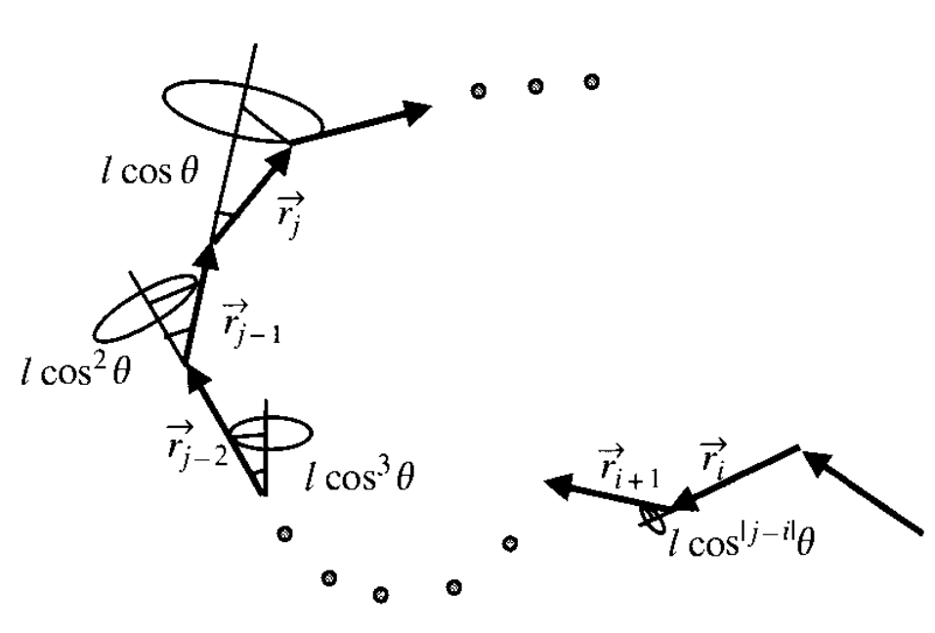
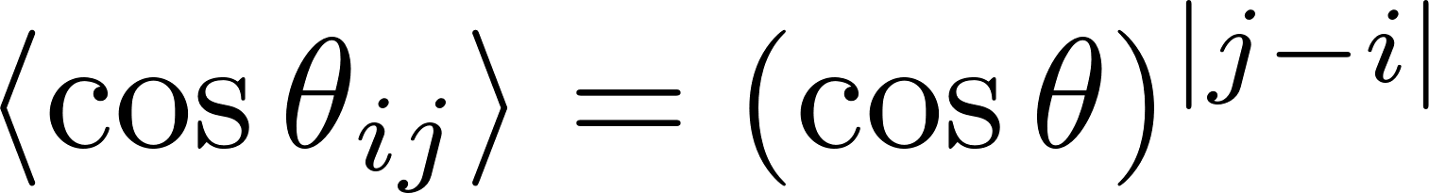

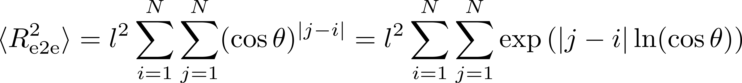
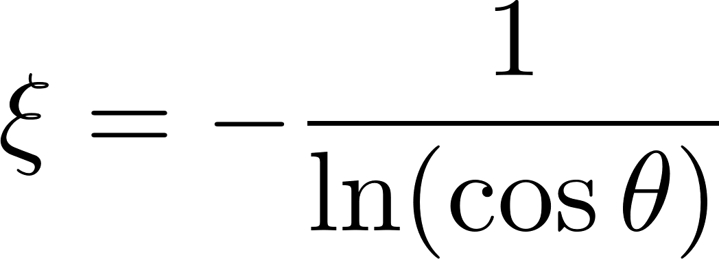
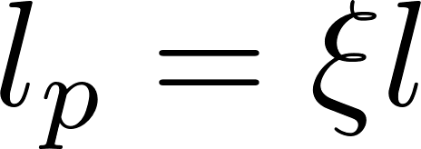
Freely Rotating Chain Model
Fixed bond length and fixed bond angle
Torsional angle is random
Number of bonds in a persistence segment
Persistence length

Slide 9

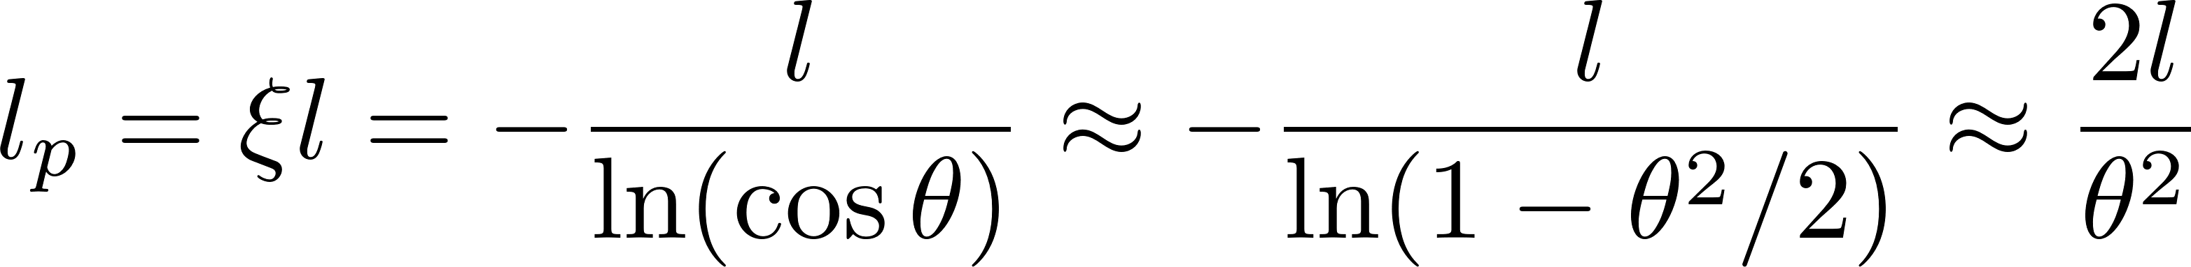
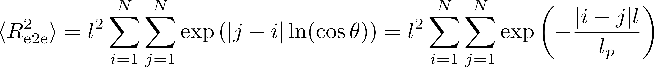
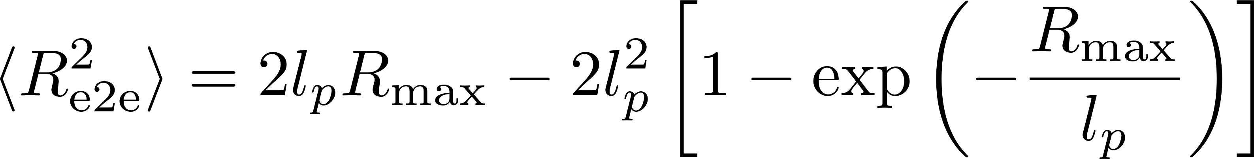
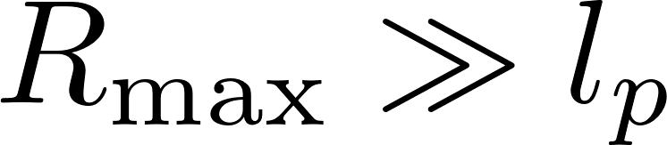
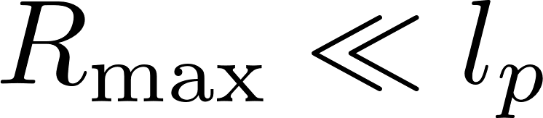
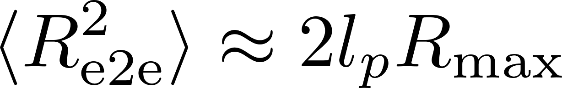
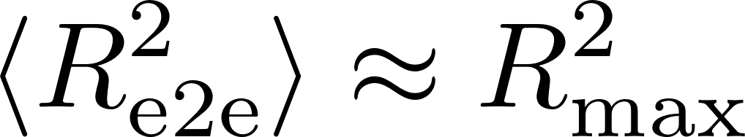
Wormlike Chain
Very small bond angle
Double stranded DNA
Taylor expand for small bond angle!
Smaller bond angle leads to large persistence length
Convert sums to integrals over the contour length
Ideal Chain Limit
Rod-like Limit

Slide 10
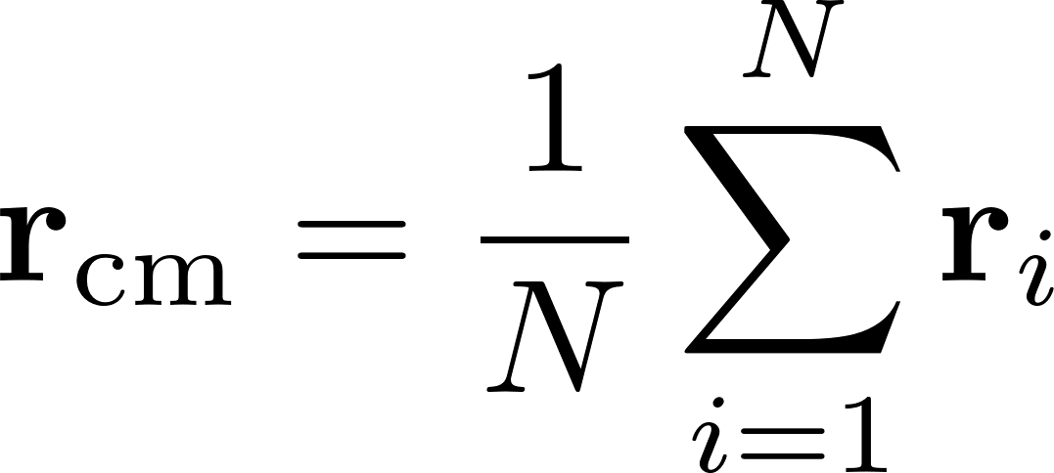
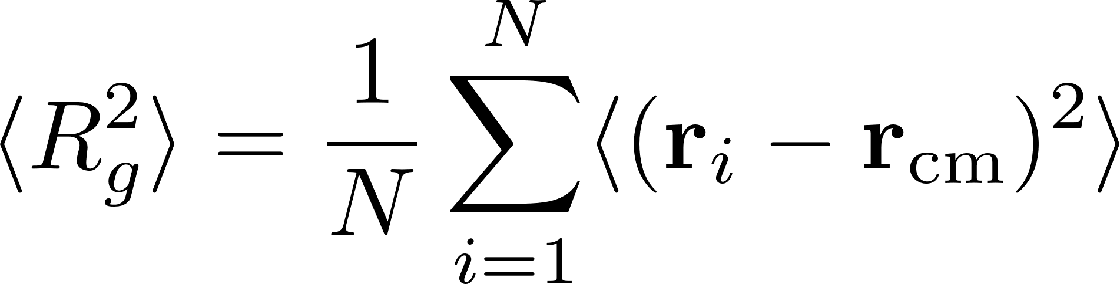
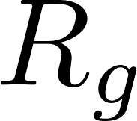
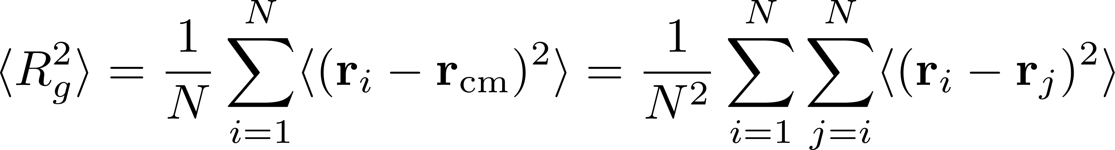
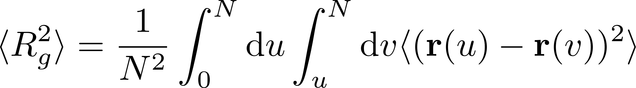
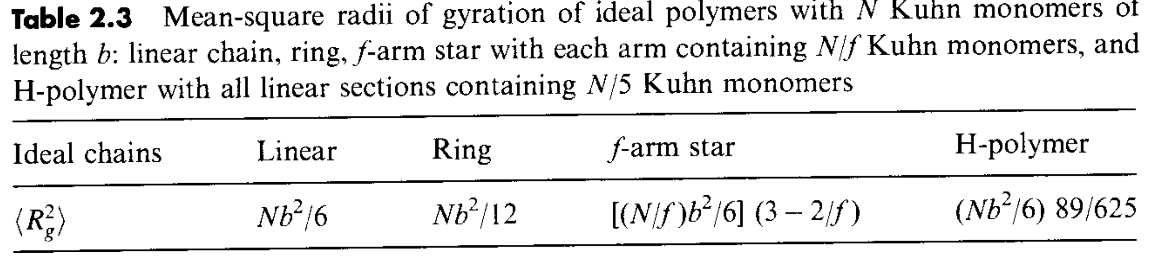
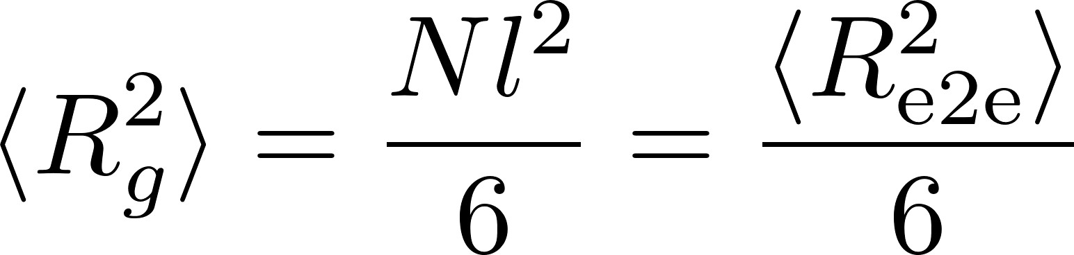
Radius of Gyration
More general than end-to-end distance
Average distance of monomers from polymer center of mass
Convert sums to integrals over the contour length
Ideal Linear Chain

Slide 11
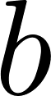
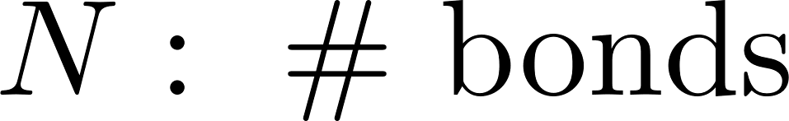
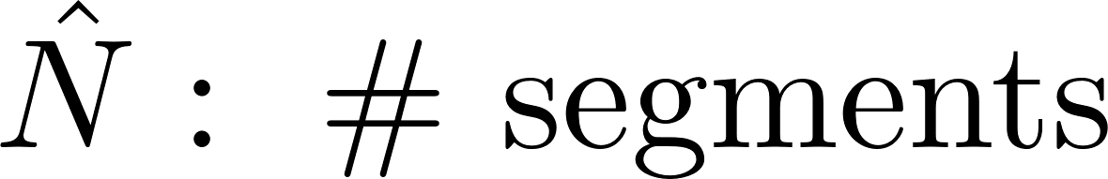
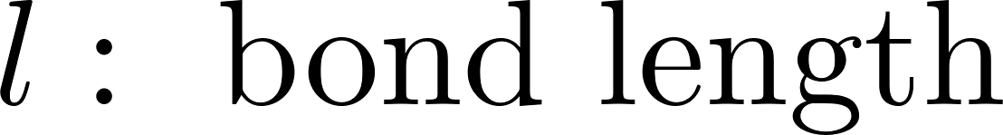








Equivalent Freely Jointed Chain
Way to map non-freely-jointed chains onto freely-jointed model
Actual Chain
Equivalent FJ Chain
Stronger bond-bond correlation leads to larger $b$ and smaller $\hat{N}$

Slide 12




Mapping Wormlike Chain to FJC
Ideal Chain Limit
Locally very persistent
Globally looks flexible
Smaller bond angle means larger persistence length, which means larger Kuhn length and less effective freely jointed segments

Slide 13




End-to-End Vector Distribution
Assume chain is long enough to be mapped onto FJC with $N$ and $b$
Bonds take a random walk in 3 independent dimensions (derive yourself!)
Distribution of end-to-end vectors is Gaussian! (central limit theorem)
Any model with $\left\langle b\right\rangle =0$ and $\left\langle b⋅b\right\rangle =b^{2}$ will result in Gaussian $P(R)$

Slide 14








Gaussian Bonds
Fixed bond length is inconvenient mathematically (see later)
Choose Gaussian bonds
Single Bond
Recall
Full Chain (bonds are independent)
Harmonic springs connected in serial
Spring Constant:

Slide 15
A Case for Gaussian Bonds
For long chains, one can divide into sub-chains that each have a Gaussian end-to-end vector distribution
Overall chain will also have Gaussian end-to-end distribution
Sub-chains form a super-bond that is Gaussian!

Slide 16

Entropic Spring Constant
Spring constant is proportional to $kT$
Origin of springiness of polymer is entropic
Stretching or compressing the chain from equilibrium necessarily decreases the available conformations, thus decreasing the entropy

Slide 17


Real Chains
Consider contacts between monomers that are far apart on the chain
How frequent are contacts?
Probability of a given monomer contacting another monomer
# of monomer-monomer contacts

Slide 18









Effective Interactions and Excluded Volume
Monomers have hard-core repulsion
Monomers may also have attractive interactions depending on solvent
Competition between repulsion and attraction determines excluded volume
Monomer-monomer interactions
Mayer $f$-function
Excluded volume
Repulsive
Attractive
Balanced

Slide 19







Solvents
Good Solvent
Theta Solvent
Poor Solvent
Effective monomer repulsion
Chain swells (rel. to ideal)
Repulsion and attraction balance
Chain behaves ideally
Effective monomer attraction
Chain shrinks (rel. to ideal)

Slide 20







Flory Theory for Good Solvent
Competition between energy and entropy
Swelling decreases entropy (less conformations)
Shrinking leads to more monomer contacts, increases energy
Free Energy of Stretching
Excluded Volume Energy
Good Solvent Result
Note that $v$ does not enter!

Slide 21







Thermal Blob
Length beyond which excluded volume becomes unimportant
Take subsection of chain with $m$ monomers and size $ξ^{3}$
Within this blob, the chain behaves ideally
Thermal Blob
Stiffer and less repulsive chains have larger thermal blobs

Slide 22



Poor Solvent
Monomers attract causing the chain to collapse
Size $ξ^{3}$
$m$ monomers
Assume a dense packing of thermal blobs
Poor Solvent Result

Slide 23


Summary
Ideal chains
Uncorrelated bonds, $R∼N^{1/2}l$
Correlated bonds, $R∼C_{∞}N^{1/2}l$, with ($C_{∞}>1$)
Equivalent FJC, $R∼\hat{N}b∼C_{∞}N^{1/2}l$
Gaussian end-to-end distribution
Informs Gaussian bond potential (superbonds)
Real Chains
Monomers feel other monomers
Excluded volume energy increases with $N$, $F_{\text{ev}}∼N^{1/2}$
Thermal blob, chain behaves ideally for $F_{\text{ev}}∼kT$
Good, Theta and Poor solvents

Slide 24
Statistical Mechanics Approach
Notes:
Hello all and thank you for attending my talk! I am a student in Zhen-Gang Wang’s group at Caltech, and today I have the privilege of presenting some of my work into the exchange mechanism for diblock copolymer micelles. This work was done in collaboration with professors Marcus Muller, Alejandro Gallegos, Timothy Lodge, and Kevin Dorfman.

Slide 25





Discrete Gaussian Chain Model
Configurational Partition Function
Full Probability Distribution
$N$ independent harmonic springs

Slide 26







Chapman-Kolmogorov Equation
Bond propagation is a stochastic process
Build up probability recursively
Probability of finding bead $j$ at position $r$
Normalized transition probability
Fourier transform (convolution theorem)
Fix bead 0 at the origin

Slide 27




Continuous Gaussian Chain
Chain is a space curve $r\left(s\right)$ with $s∈[0,N]$
$s$ is the location of a segment on the backbone
$r(s)$ is the location of that segment in space
[] functional
Continuous chain results in a PDE for the probability distribution

Slide 28






Solving the Fokker-Planck Equation
Fix chain end at origin
Fundamental Solution (Green’s Function)
Compute segment density distribution
Probability that chain of $s$ segments originating at origin ends at $r$
Probability that chain of $N−s$ segments originating at $r$ ends at $R$

Slide 29


Chain with Fixed End

Slide 30



Two-Point Green’s Function
Conditional probability that the chain-end is located at $r$ given that the other chain end is located at $r′$
Often-times reduces to symmetric case

Slide 31


Gaussian Chain in External Potential
Segment density is conjugate to external chemical potential field
Chain partition function
Density of chain in external field

Slide 32




Ground-State Dominance
Full Solution
Self-adjoint Sturm-Liouville operator
Truncate (GSD)
Very large $N$ means terms decay rapidly
GSD Condition
$$\exp\left[−N\left(Λ_{1}−Λ_{0}\right)\right]≪1$$

